Slide 1
Artificial Intelligence cs-511
Modified slides of Prof. Mohamed Batouche, KSU, KSA.

Slide 2
Problem solving and search

Slide 3
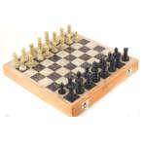
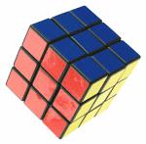
Problem Solving by Searching
Why search ?
Early works of AI was mainly towards
proving theorems
solving puzzles
playing games
All AI is search!
Not totally true (obviously) but more true than you might think.
All life is problem solving !!
Finding a good/best solution to a problem amongst many possible solutions.

Slide 4
Chapter 3
Describes one kind of goal-based agent called a problem-solving agent.
These agents use atomic representations
States of the world are considered as wholes, with no internal structure visible to the problem-solving algorithms

Slide 5
What we study
Several general-purpose search algorithms that can be used to solve these problems.
Uninformed search algorithms
algorithms that are given no information about the problem other than its definition
Although some of these algorithms can solve any solvable problem, none of them can do so efficiently
Informed search algorithms
can do quite well given some guidance on where to look for solutions (next chapter)

Slide 6
Assumptions about the task environment
static
single agent
deterministic
observable
discrete

Slide 7
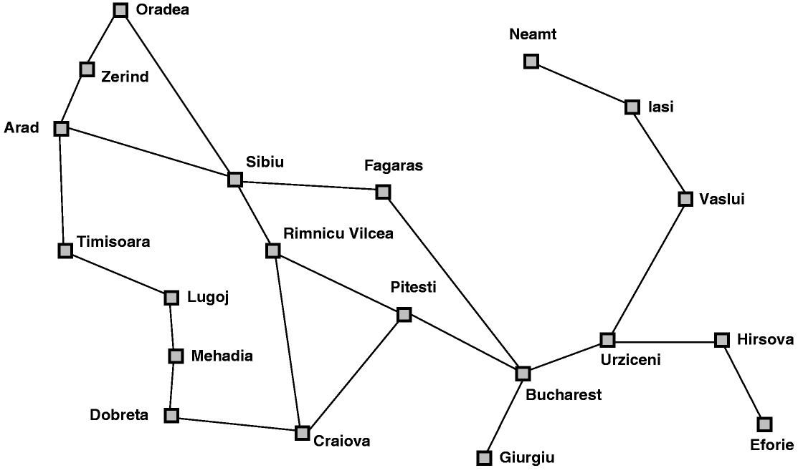
Classic AI Search Problems
Map searching (navigation)

Slide 8
Classic AI Search Problems
3*3*3 Rubik’s Cube

Slide 9
Classic AI Search Problems
8-Puzzle
2
1
3
1
2
3
4
7
6
4
5
6
5
8
7
8

Slide 10
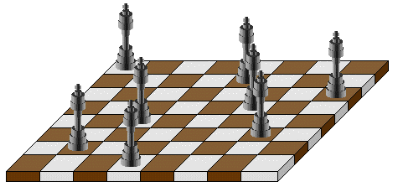
Classic AI Search Problems
N-Queens
Problem of placing n chess queens on an n×n chessboard so that no two queens attack each other
A solution requires that no two queens share the same row, column, or diagonal

Slide 11
Classic AI Search Problems
5-Queens:
1
2
3
4
5
1
2
3
4
5

Slide 12
Classic AI Search Problems
5-Queens:
1
2
3
4
5
1
2
3
4
5

Slide 13
Classic AI Search Problems
5-Queens:
1
2
3
4
5
1
2
3
4
5

Slide 14
Classic AI Search Problems
5-Queens:
1
2
3
4
5
1
2
3
4
5

Slide 15
Classic AI Search Problems
5-Queens:
1
2
3
4
5
1
2
3
4
5

Slide 16
Classic AI Search Problems
5-Queens:
1
2
3
4
5
1
2
Solution !!
No Queen is under Attack
3
4
5

Slide 17
Missionaries and cannibals
Three missionaries and three cannibals are on the left bank of a river.
There is one boat which can hold one or two people.
Find a way to get everyone to the right bank, without ever leaving a group of missionaries in one place outnumbered by cannibals in that place.

Slide 18
Missionaries and Cannibals
Initial State

Slide 19
Missionaries and Cannibals
Goal State

Slide 20
The River Problem
A farmer wishes to carry a wolf, a duck and corn across a river, from the south to the north shore. The farmer has a small rowing boat. The boat can only carry at most the farmer and one other item.
If left unattended the wolf will eat the duck and the duck will eat the corn.
How can the farmer safely transport the wolf, the duck and the corn to the opposite shore?
Farmer, Wolf,
Duck and Corn
River
River
boat
boat
Farmer, Wolf,
Duck and Corn

Slide 21
Problem Solving by Searching
Problem Formulation

Slide 22
Problem Formulation
A Problem Space consists of
The current state of the world (initial state)
A description of the actions we can take to transform one state of the world into another (operators or successor function).
A description of the desired state of the world (goal state), this could be implicit or explicit.
A solution consists of the goal state, or a path to the goal state.

Slide 23
Classic AI Search Problems
Map searching (navigation)

Slide 24
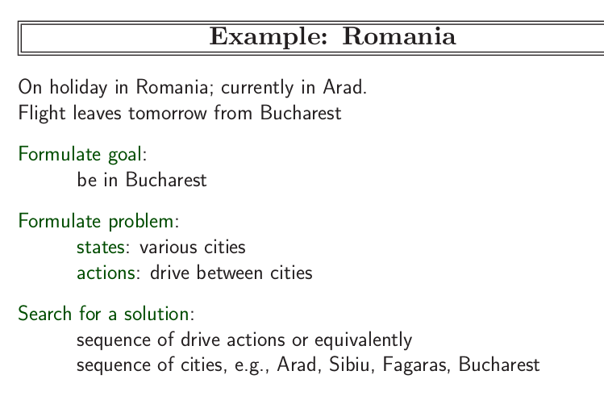

Slide 25
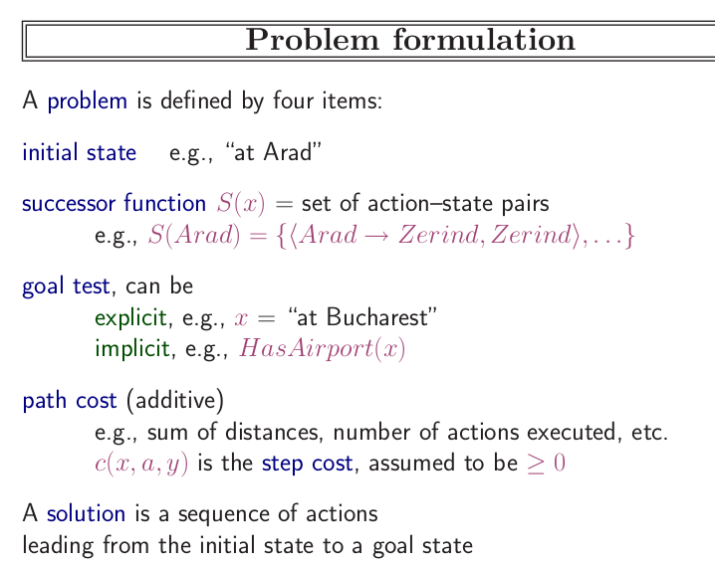

Slide 26
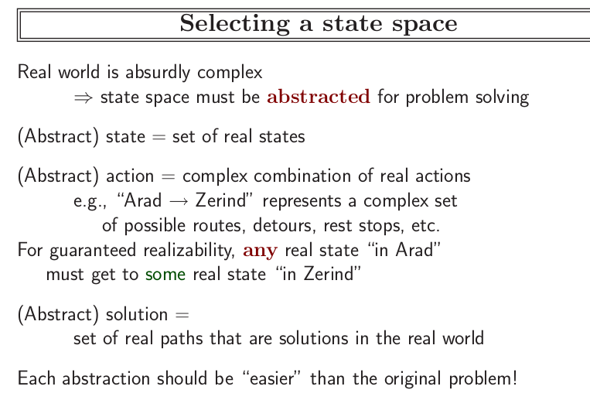

Slide 27
Problem Formulation 8-Puzzle Problem
Initial State
Operators
Goal State
2
1
3
Slide blank square left.
Slide blank square right.
….
1
2
3
4
7
6
4
5
6
5
8
7
8

Slide 28
Problem Formulation 8-Puzzle Problem
Representing states:
For the 8-puzzle
3 by 3 array
5, 6, 7
8, 4, BLANK
3, 1, 2
A vector of length nine
5, 6, 7, 8, 4, BLANK, 3, 1, 2
A list of facts
Upper_left = 5
Upper_middle = 6
Upper_right = 7
Middle_left = 8
5
6
7
8
4
3
1
2

Slide 29
Problem Formulation 8-Puzzle Problem
Specifying operators
There are often many ways to specify the operators, some will be much easier to implement...
Move 1 left
Move 1 right
Move 1 up
Move 1 down
Move 2 left
Move 2 right
Move 2 up
Move 2 down
Move 3 left
Move 3 right
Move 3 up
Move 3 down
Move 4 left
…
5
6
7
Move Blank left
Move Blank right
Move Blank up
Move Blank down
8
4
3
1
2

Slide 30
Problem Formulation 8-Puzzle Problem
1
2
3
1
2
3
4
8
4
5
6
7
6
5
7
8
Initial state
Goal state
Operators: slide blank up, slide blank down, slide blank left, slide blank right
1
2
3
1
2
3
1
2
3
1
2
3
1
2
3
1
2
3
4
8
4
8
5
4
8
5
4
5
4
5
4
5
6
7
6
5
7
6
7
6
7
8
6
7
8
6
7
8
Solution: sb-down, sb-left, sb-up,sb-right, sb-down
Path cost: 5 steps to reach the goal

Slide 31
Missionaries and cannibals
Three missionaries and three cannibals are on the left bank of a river.
There is one boat which can hold one or two people.
Find a way to get everyone to the right bank, without ever leaving a group of missionaries in one place outnumbered by cannibals in that place.

Slide 32
Missionaries and cannibals
States: three numbers (i, j, k) representing the number of missionaries, cannibals, and boats on the left bank of the river.
Initial state: (3, 3, 1)
Operators: take one missionary, one cannibal, two missionaries, two cannibals, one missionary and one cannibal across the river in a given direction
Goal Test: reached state (0, 0, 0)
Path Cost: Number of crossings.

Slide 33
Missionaries and Cannibals
(3,3,1): Initial State

Slide 34
Missionaries and Cannibals
A missionary and cannibal cross

Slide 35
Missionaries and Cannibals
(2,2,0)

Slide 36
Missionaries and Cannibals
One missionary returns

Slide 37
Missionaries and Cannibals
(3,2,1)

Slide 38
Missionaries and Cannibals
Two cannibals cross

Slide 39
Missionaries and Cannibals
(3,0,0)

Slide 40
Missionaries and Cannibals
A cannibal returns

Slide 41
Missionaries and Cannibals
(3,1,1)

Slide 42
Missionaries and Cannibals
Two missionaries cross

Slide 43
Missionaries and Cannibals
(1,1,0)

Slide 44
Missionaries and Cannibals
A missionary and cannibal return

Slide 45
Missionaries and Cannibals
(2,2,1)

Slide 46
Missionaries and Cannibals
Two Missionaries cross

Slide 47
Missionaries and Cannibals
(0,2,0)

Slide 48
Missionaries and Cannibals
A cannibal returns

Slide 49
Missionaries and Cannibals
(0,3,1)

Slide 50
Missionaries and Cannibals
Two cannibals cross

Slide 51
Missionaries and Cannibals
(0,1,0)

Slide 52
Missionaries and Cannibals
A cannibal returns

Slide 53
Missionaries and Cannibals
(0,2,1)

Slide 54
Missionaries and Cannibals
The last two cannibals cross

Slide 55
Missionaries and Cannibals
(0,0,0) : Goal State

Slide 56
Missionaries and Cannibals
Solution = the sequence of actions within the path :
[(3,3,1)→ (2,2,0)→(3,2,1) →(3,0,0) →(3,1,1) →(1,1,0) →(2,2,1) →(0,2,0) →(0,3,1) →(0,1,0) → (0,2,1) →(0,0,0)]
Cost = 11 crossings

Slide 57
The River Problem
A farmer wishes to carry a wolf, a duck and corn across a river, from the south to the north shore. The farmer has a small rowing boat. The boat can only carry at most the farmer and one other item.
If left unattended the wolf will eat the duck and the duck will eat the corn.
How can the farmer safely transport the wolf, the duck and the corn to the opposite shore?
Farmer, Wolf,
Duck and Corn
River
River
boat
boat
Farmer, Wolf,
Duck and Corn

Slide 58
The River Problem
The River Problem:
F=Farmer W=Wolf D=Duck C=Corn /=River
How can the farmer safely transport the wolf, the duck and the corn to the opposite shore?
-/FWCD
FWCD/-

Slide 59
The River Problem
Problem formulation:
State representation: location of farmer and items in both sides of river
[items in South shore / items in North shore] : (FWDC/-, FD/WC, C/FWD …)
Initial State: farmer, wolf, duck and corn in the south shore FWDC/-
Goal State: farmer, duck and corn in the north shore
-/FWDC
Operators: the farmer takes in the boat at most one item from one side to the other side
(F-Takes-W, F-Takes-D, F-Takes-C, F-Takes-Self [himself only])
Path cost: the number of crossings

Slide 60
The River Problem
Problem solution: (path Cost = 7)
While there are other possibilities here is one 7 step solution to the river problem
F
D
D
F
W
D
F-Takes-D
F-Takes-S
F-Takes-W
F
W
D
C
W
C
F
W
C
C
Initial State
WC/FD
FWC/D
C/FWD
F-Takes-D
F
W
D
C
W
C
F
W
C
W
F-Takes-D
F-Takes-S
F-Takes-C
F
D
D
F
D
C
Goal State
FD/WC
D/FWC
FDC/W

Slide 61
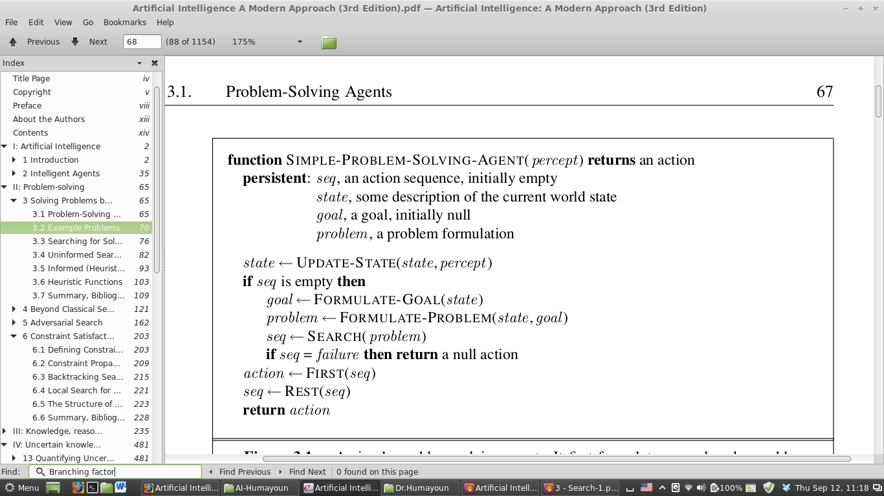

Slide 62
Summary
Search: process of constructing sequences of actions that achieve a goal given a problem.
It is assumed that the environment is observable, deterministic, static and completely known.
Goal formulation is the first step in solving problems by searching. It facilitates problem formulation.
Formulating a problem requires specifying five components: State representation, Initial state, Goal state, Operators (actions), and Path cost function.

Slide 63

Questions

